Slide 1
School Finder
Vincent Xie, Evan Amster

Slide 2
URL
http://sample-env.b7yfq9vyc8.us-west-2.elasticbeanstalk.com/
Tested on Google Chrome

Slide 3
Audience
Prospective students and their parents who are looking for colleges based upon their cost effectiveness.
Would visit the site when choosing which schools to apply to
Would return to the site when choosing between schools after application results
Would like to visually distinguish good schools from not so good schools and compare them to the average
Have a scoring system based upon how cost-effective the school is

Slide 4
Walkthrough
There are two main pages
Map page
Browse page
Map page for getting in-depth information about the school
Browse page for getting information about many schools in a table for comparison

Slide 5
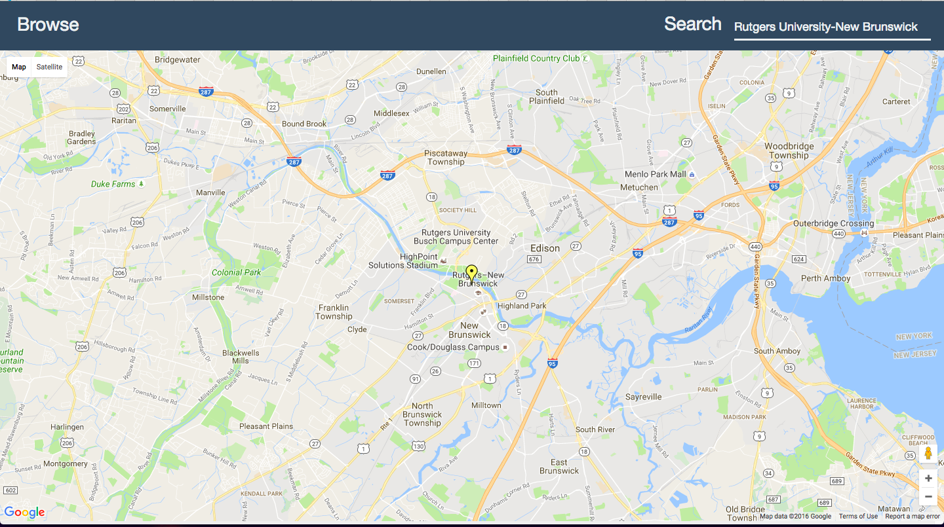
Map page
Button to the browse page
Search box
Clickable marker for the school

Slide 6
Map page notes
To open up the sidebar, click on the marker for the school.
Depending on the score for the school, the marker will have a different color
The best schools will have a green marker, worst schools will get orange, red etc.

Slide 7
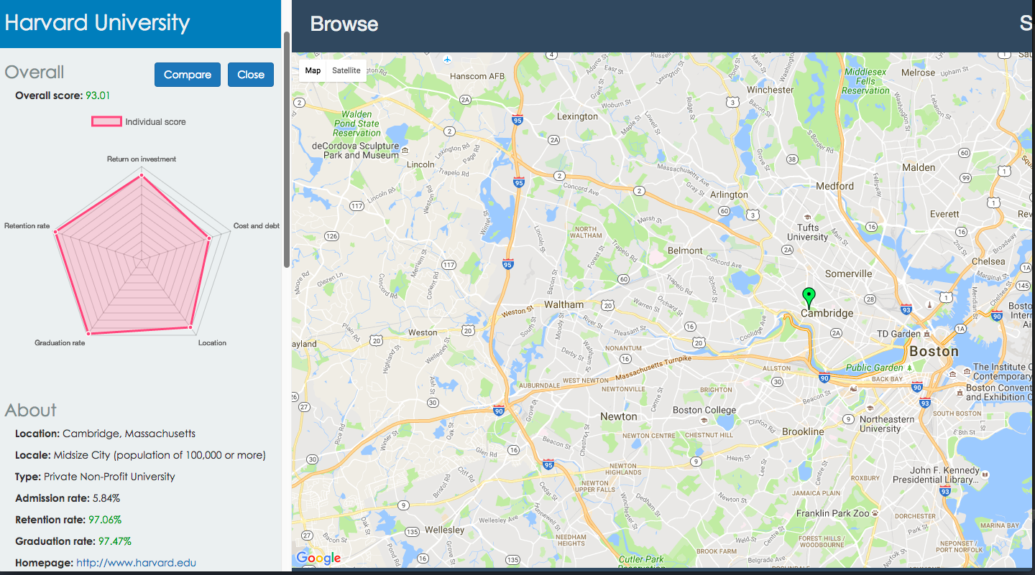
Side bar
Overall score
Button to compare school
To close the side bar, click on the map

Slide 8
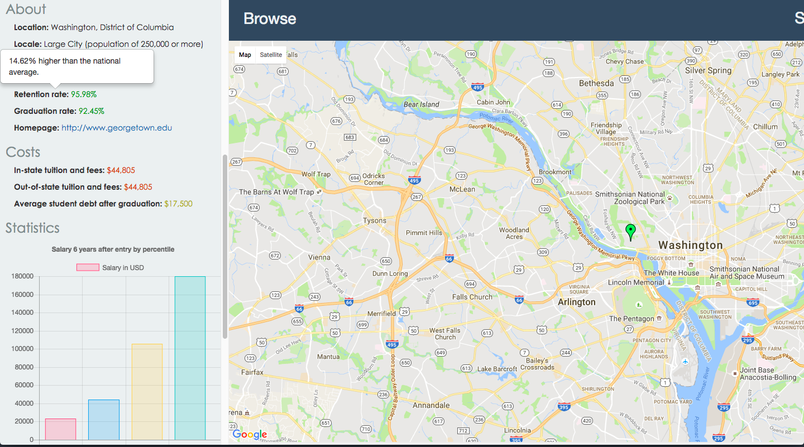
Side bar continued
Hover over to see comparisons to the average
Dynamic colors

Slide 9
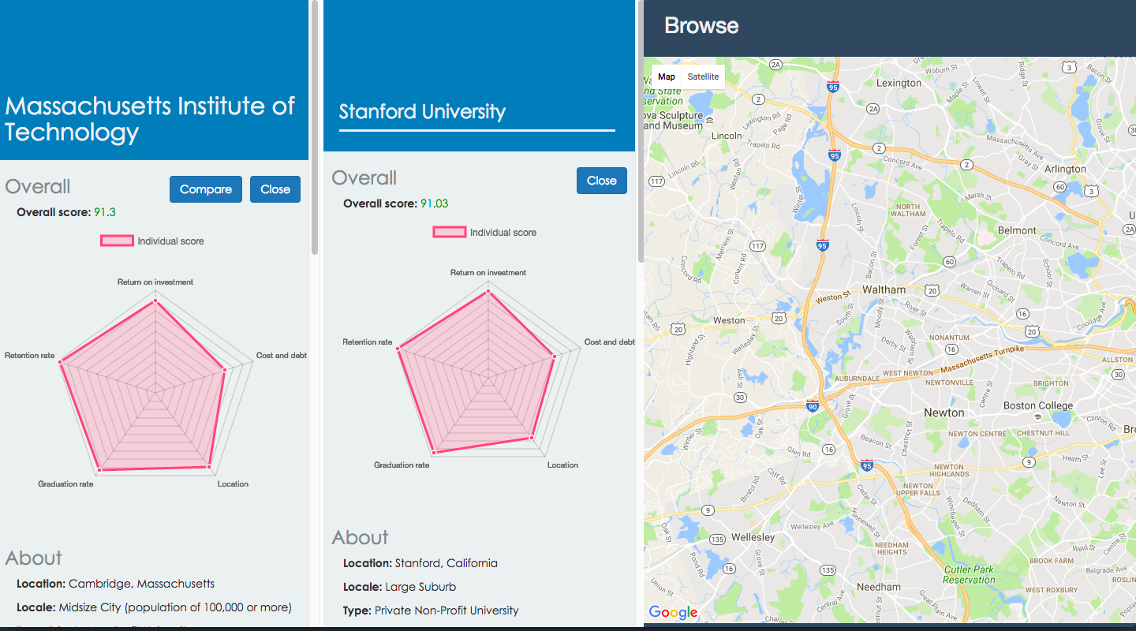
Compare
Button to toggle compare tab
Search schools
Close compare tab

Slide 10
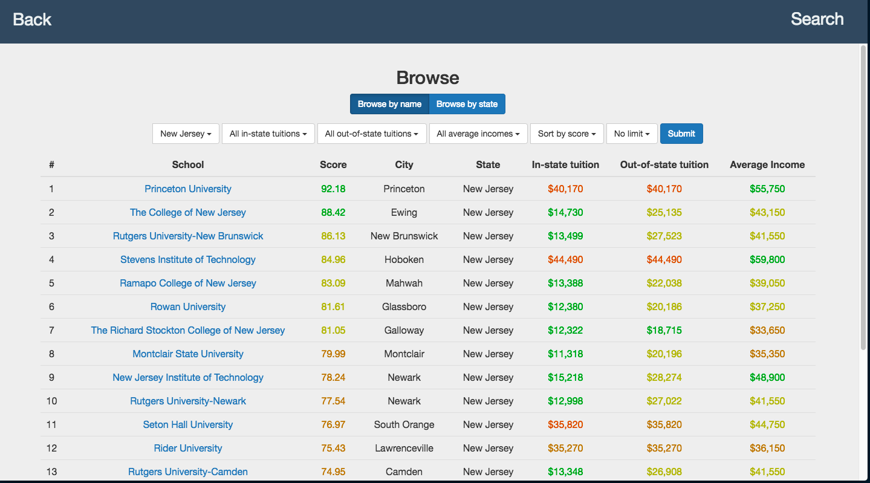
Browse Page
Clickable links to map
Browse by school name or state
Filters

Slide 11
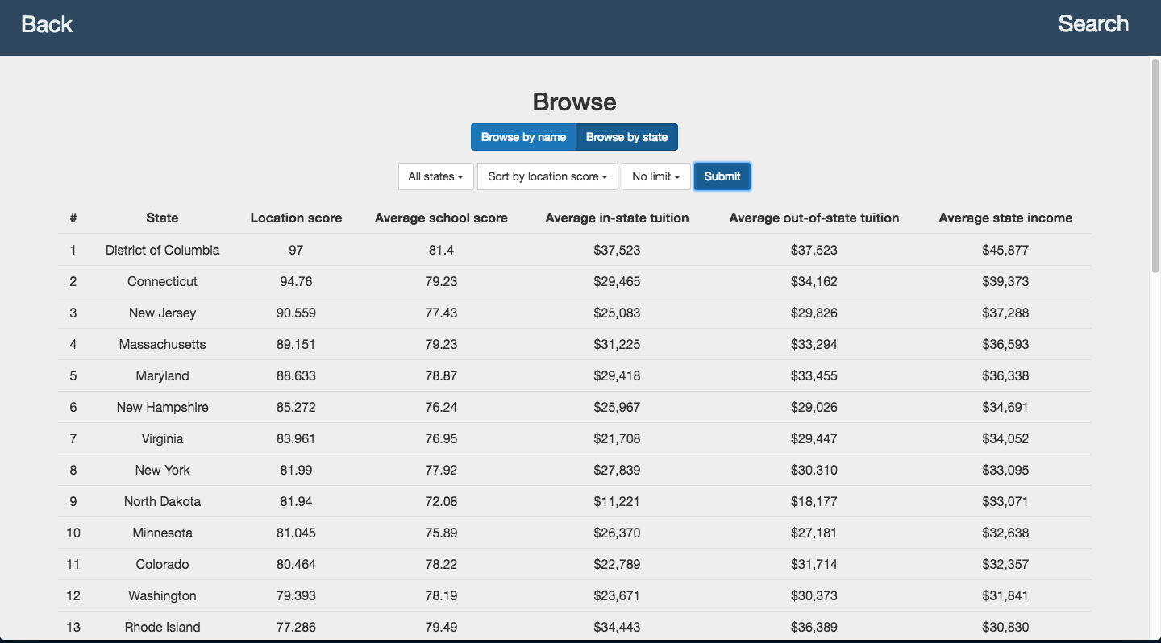
Browse by state
Filters

Slide 12
Sample Workflow
Student wants to gather a list of schools to apply to.
Lives in New Jersey
Has a budget of $30,000 a year and wants to go to school in New Jersey
Wants a salary of at least $40,000 a year after graduation
Goes to the browse page to get a list
Can see how the cost for each school compares by inspecting the colors
Wants to find the list of schools that are the best value

Slide 13
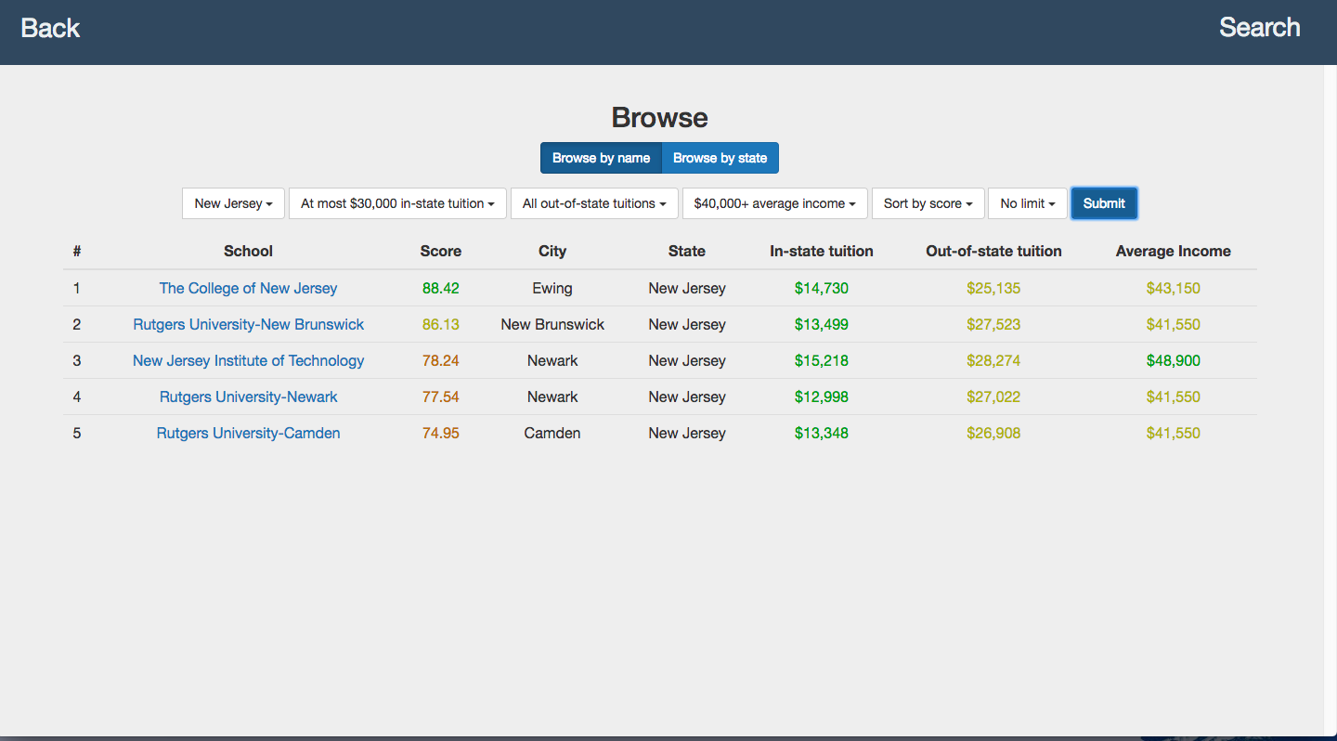
Sample Workflow
The student should apply to these schools.

Slide 14
Another sample workflow
A student just got back application results
Wants to choose between schools (Yale and Harvard)
Can go to the map and check the surrounding area and get specific information about their schools
Can compare schools that the student is accepted to
Help the student make a decision

Slide 15
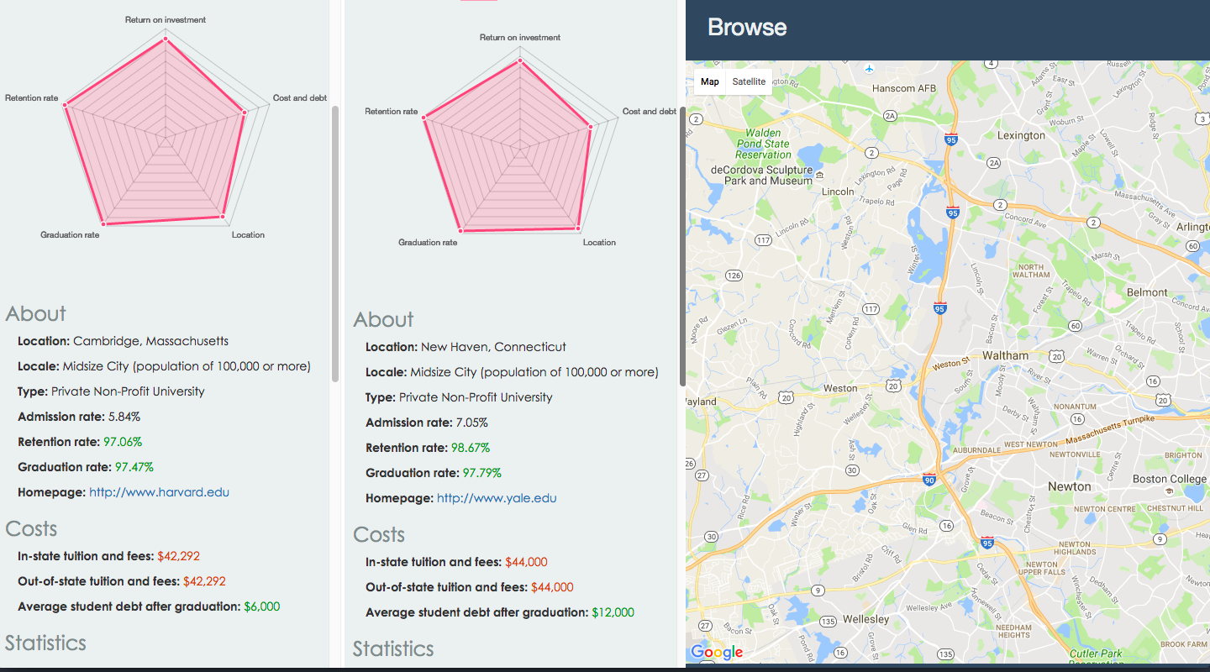
Another sample workflow
Yale is more expensive than Harvard

Slide 16
Scoring formula
Return on investment score = 1 - 1 / ((school.salary_twentyfive + school.salary_seventyfive) / 2 / ((school.in_state_tuition + school.out_of_state_tuition) / 2)) / 5
Cost score = 1 - 1 / (100000 / ((school.in_state_tuition + school.out_of_state_tuition + 2 * school.average_student_debt) / 4))
State score is calculated based upon the average salary
Graduation score = school.graduation_rate
Retention score = school.retention_rate

Slide 17
Scoring formula continued
Total score = .2 * return on investment score + .1 * cost score + .1 * state score + .3 * graduation score + .3 * retention score
The graduation and retention scores are weighted highly.
This prevents cheap but low quality schools (low graduation and retention rate) from rising to the top.
Takes into account average cost of the school, average student debt, average income of graduates, average income of location, retention rate, graduation rate

Slide 18
Architecture
Standard HTML/CSS, Javascript front end
AngularJS as a front end framework
Bootstrap, Chart.JS for UI elements
JQuery animations
Google Maps API
AJAX requests to PHP backend which communicates with MySQL database

Slide 19
Platform and Design
Hosted on AWS using EC2
MySQL instance run on AWS using RDS
Simple design
User Interface
PHP
AJAX request
Map requests
Google Maps API
MySQL Database

Slide 20
Data Sources
School data: https://catalog.data.gov/dataset/college-scorecard
State data: https://en.wikipedia.org/wiki/List_of_U.S._states_by_income
State codes: https://www.census.gov/geo/reference/ansi_statetables.html

Slide 21
Database Schema
SCHOOLS[name, latitude, longitude, city, locale, in_state_tuition, out_of_state_tuition, type, homepage, graudation_rate, retention_rate, admission_rate, average_student_debt, salary_ten, salary_twentyfive, salary_seventyfive, salary_ninety, drr_oneyr, drr_threeyr, drr_fiveyr, drr_sevenyr]
LOCATED[school, state_code]
STATES[name, code, avg_salary, score]

Slide 22
Queries
To prevent SQL injection vulnerability, we use prepared queries
‘?’ gets replaced with input

Slide 23
Some Queries
To get information about a school:
SELECT * FROM schools WHERE name = ?;
To get the state of a specific school:
SELECT * FROM located, states WHERE located.school = ? AND located.state_code = states.code;
To calculate averages:
SELECT AVG(retention_rate) AS retention_rate, AVG(graduation_rate) AS graduation_rate, ROUND(AVG(in_state_tuition), 2) AS in_state_tuition, ROUND(AVG(out_of_state_tuition), 2) AS out_of_state_tuition, ROUND(AVG(average_student_debt), 2) AS average_student_debt, ROUND(AVG((salary_twentyfive + salary_seventyfive) / 2), 2) AS average_income FROM schools;

Slide 24
More Queries
Browse schools:
SELECT s.name, .2 * (1 - 1 / ((s.salary_twentyfive + s.salary_seventyfive) / 2 / ((s.in_state_tuition + s.out_of_state_tuition) / 2)) / 5) + .1 * (1 - 1 / (100000 / ((s.in_state_tuition + s.out_of_state_tuition + 2 * s.average_student_debt) / 4))) + .1 * st.score / 100 + .3 * s.graduation_rate + .3 * s.retention_rate AS 'score', s.city, s.in_state_tuition, s.out_of_state_tuition, (s.salary_twentyfive + s.salary_seventyfive) / 2 AS 'average_salary', st.name AS 'state' FROM schools s, located l, states st WHERE s.in_state_tuition >= ? AND s.in_state_tuition <= ? AND s.out_of_state_tuition >= ? AND s.out_of_state_tuition <= ? AND (s.salary_twentyfive + s.salary_seventyfive) / 2 >= ? AND (s.salary_twentyfive + s.salary_seventyfive) / 2 <= ? AND s.name = l.school AND l.state_code = st.code AND l.state_code = ? ORDER BY " . $sort_by . " ASC LIMIT ?;

Slide 25
More Queries
Browse by state:
SELECT st.name, st.score, AVG(.2 * (1 - 1 / ((s.salary_twentyfive + s.salary_seventyfive) / 2 / ((s.in_state_tuition + s.out_of_state_tuition) / 2)) / 5) + .1 * (1 - 1 / (100000 / ((s.in_state_tuition + s.out_of_state_tuition + 2 * s.average_student_debt) / 4))) + .1 * st.score / 100 + .3 * s.graduation_rate + .3 * s.retention_rate) AS 'average_school_score', ROUND(AVG(s.in_state_tuition), 2) AS 'average_in_state_tuition', ROUND(AVG(s.out_of_state_tuition), 2) AS 'average_out_of_state_tuition', st.avg_salary FROM schools s, located l, states st WHERE s.name = l.school AND l.state_code = st.code AND st.code = ? GROUP BY st.name ASC ORDER BY " . $sort_by . " DESC LIMIT ?;

